Slide 1
WomenTechWomenYes
Street Team Strategy
January 8, 2021
Grettel Juárez
Kevin Liang
Yuwen Huang

Slide 2
WTWY Street Team Goal
Background
WTWY:
Aims to increase participation of women in technology
Hosts annual gala
Objectives
Maximize gala attendees and contributions
Extend diversity awareness
Goal
Collect signatures and extend free invitations to gala
Deploy street teams to entrances of subway stations
Challenge: Use MTA subway data to identify optimal subway station positions

Slide 3
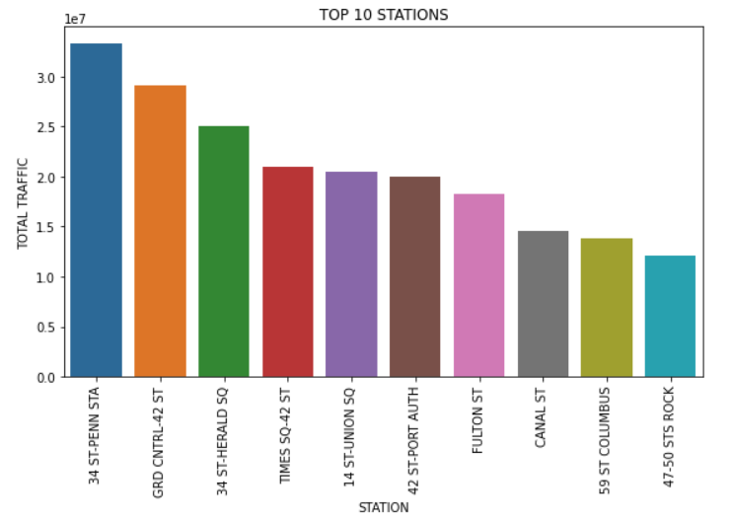
Subway Data Analysis
Analysis Approach
Top 10 Results
Analyzed MTA turnstile data from April through July 2019
Identified:
Top 10 stations using the highest total traffic over the time period
Target days and times for street team deployment
Stations by Volume
(April - July 2019)
~9% total volume
Highest Priority
~11% total volume

Slide 4
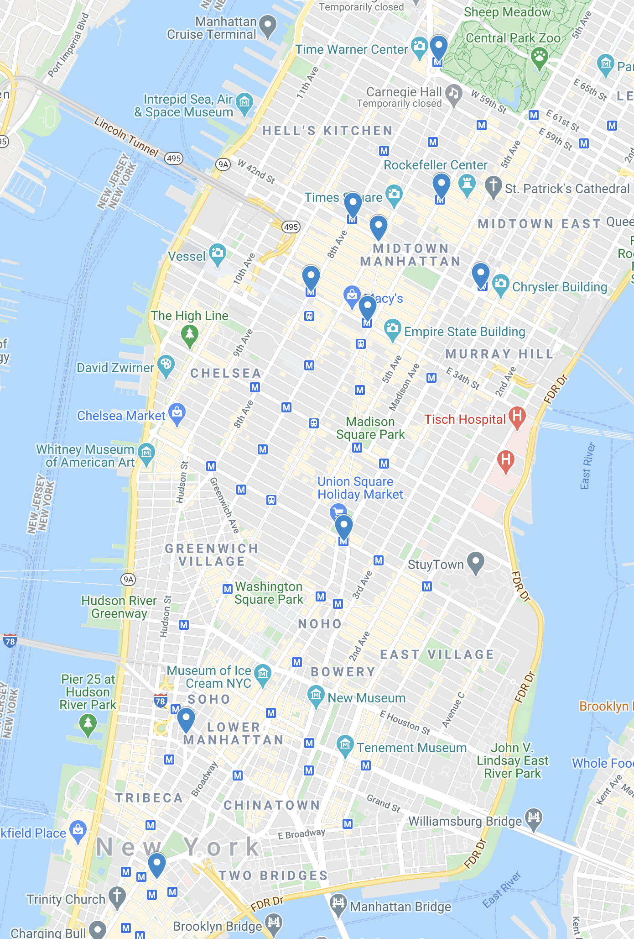
Top 10 Station Locations
9
10
6
1. 34 St-Penn Station
4
6. 42 ST-Port Authority
1
2
3
2. Grand Central Station
7. Fulton Street
3. 34 St-Herald Square
8. Canal St
5
4. 42 St-Times Square
9. 59 St Columbus
5. 14 St-Union Square
8
10. 47-50th Sts Rockefeller Center
Target high volume stations based on street team size and proximity.
7
Note: Stations have multiple entrances

Slide 5
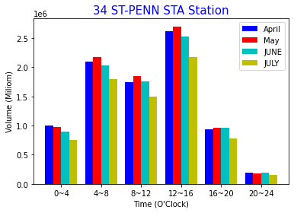
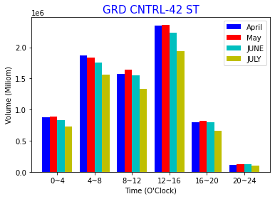
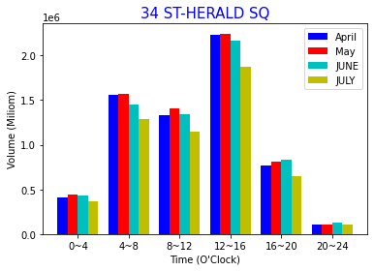
TOP 3 Stations: Hourly Traffic
30% total traffic occurs between 12 to 4pm

Slide 6
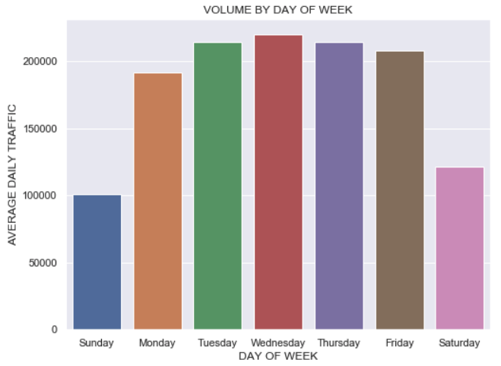
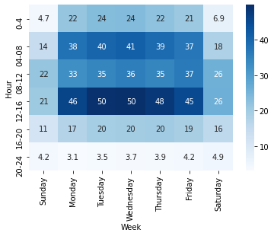
Target Days/Times
Avg Daily Volume By Day of Week
Total Traffic Volume by Day of Week & Hour Range
(Millions)
83%
Higher traffic volume observed on weekdays
Mondays through Fridays make up 83% of the week’s volume
Two periods consistently show heavier traffic and are optimal times for placing teams
4AM-8AM
12PM-4PM

Slide 7
Conclusion
What we found from turnstile data:
TOP 10 Stations with highest traffic volume
Weekdays had higher traffic than weekend
Peak hours during a day: 12pm-4pm
Recommendations for WTWY:
In order to efficiently advertise annual gala, we recommend campaign team focus on Top 3 Stations during weekdays 12pm-4pm
Consider street team size and proximity when strategizing additional locations

Slide 8
Potential Further Improvements
Target each NYC borough outside of only Manhattan to increase community reach and awareness
Analyze wider range of data to further investigate subway station traffic trends
Consider impacts of tourism to volumes
Incorporate additional data set to potentially target locations with higher likelihood of gala attendance and contribution to the organization

Slide 9

Thanks!
Any questions?

Slide 10
APPENDIX

Slide 11
Data Cleansing Approach
Filtered for only subway station divisions: BMT, IND, IRT
Removed duplicate records caused by "RECOVER AUD" in desc column
Removed outliers: traffic volume > 14,400 (1 person per second)
Used absolute values to calculate differences between record periods. This was done to address turnstiles decrementing instead of incrementing
Modified station names for stations with numbers in the name. Those have the same name across several blocks on the same street

Slide 12
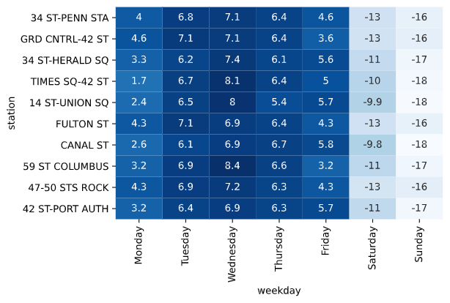
Top 10 Stations by Day of Week
Day of Week Heatmap by Station
Values are normalized across rows within each station to reflect differences in days of the week

Slide 13
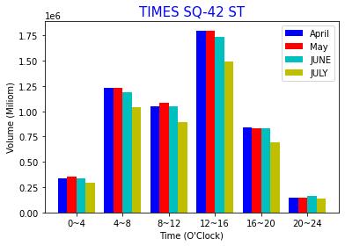
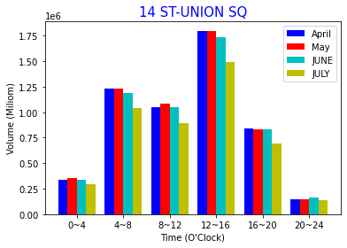
Hourly Traffic for Additional Stations

